Slide 1
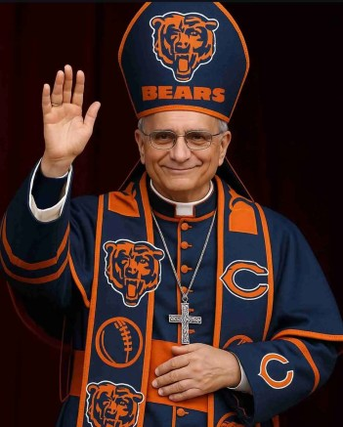
Exploring a correlation between sports teams and Violent crime: Chicago and the Chicago bears
Information Brief: 11 March 2026
UNCLASSIFIED
Maj Schwarzbach, Dario
Capt Franco, Katerina
Capt Franco, Jackson
NPS OR Department

Slide 2
Introduction
Analyze the data three ways:
General correlation between Bears success and violent crime rate
Sunday with a game compared to a Sunday with no game
Location of the crimes committed
Are there any correlations between the Chicago Bears success rate and the violent crime rate in Chicago?

Slide 3
Data Acquisition
Data Source | Usage Reasoning
City of Chicago API | Provided the most detailed CSV, for example, location, timestamps, and type of crime Socrata API (SQL like queries) Contained data from 2001 - present
FBI.gov | Only contained broad information about the crimes committed Contained data from 1985 - present
Text-based Police Reports | Used to fill in gaps for information, text recognition required to synthesize information Provided data for before 1985
profootballreference.com | Included incredibly robust NFL data, however, no API and required web scraping with Selenium Contained data from the origin of the Chicago Bears to present
nflreadpy library | Returns data in pandas or polars dataframes with ease Provides NFL schedules dating back to 1990

Slide 4
App Link
Streamlit Links:
https://oldbearcrimes.streamlit.app/ https://bearcrimes.streamlit.app/

Slide 5
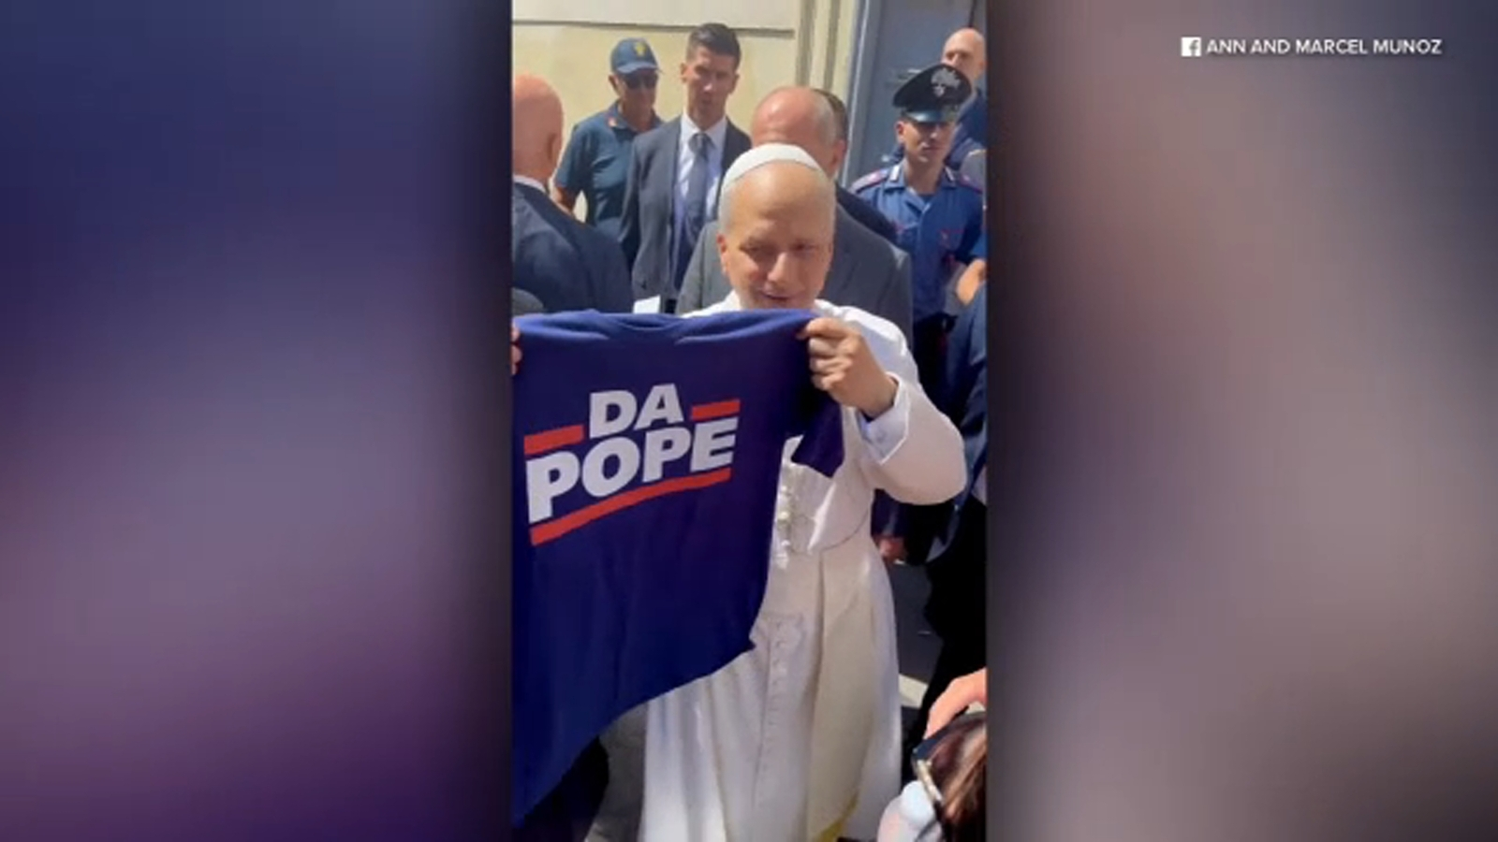
Future Work
Define "success of the Chicago Bears" with a new metric
Analyze a different sports team in Chicago
New fan base
Sport in a different season
Analyze a different location and/or sport
Cultural differences across cities or countries may affect reactions
Capture a wide range of sports and fan base patterns

Slide 6
Questions
Contact Information:
Maj Dario Schwarzbach:
dario.schwarzbach.gy@nps.edu
Capt Katerina Franco:
katerina.franco@nps.edu
Capt Jackson Franco:
jackson.franco@nps.edu

